Slide 1
Imagine confetti
Vi viser quick and dirty – Experience Economy

Slide 2
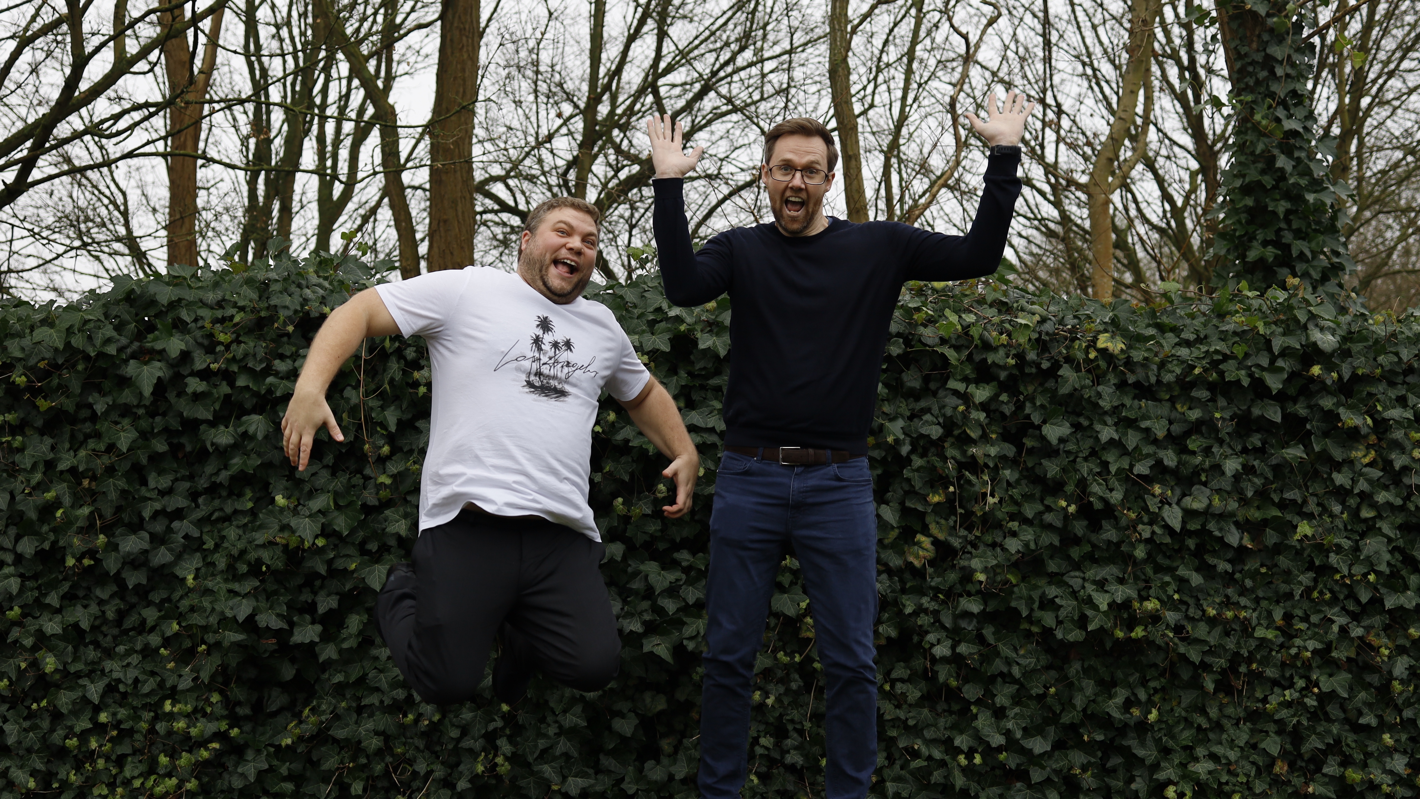
The Service Show and
Zealand at OEB

Slide 3
Questions for you …
How many of you use videos in your teaching?
How many of you, are working on developing and recording videos?
  What are you afraid of?
How many skills do you need, when you want to record and edit videos?
Are written assignements used, because it is more academically correct?
Is it more exciting to watch a video of five minutes, or read a text for 30 minutes?

Slide 4
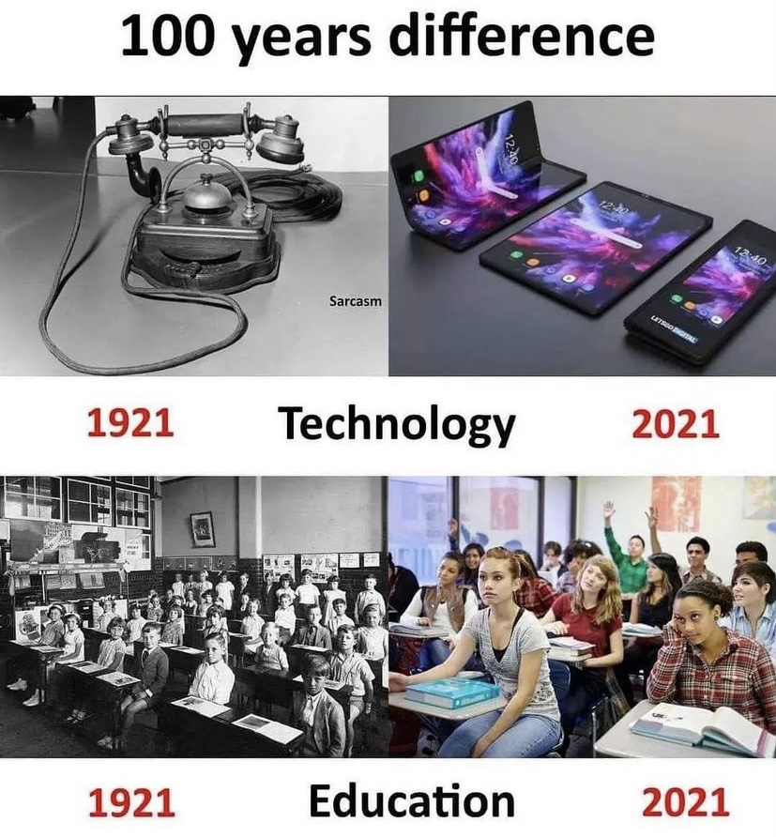
What’s in it
- for you!
Learn to structure a course through videos
Happier students
Less preparation / preparation efficiency

Slide 5
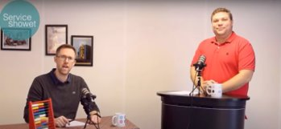
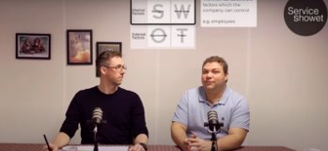
What is learning videos?
What is it NOT! – but what are the expectations
Length of videos
  Our analytical data shows short videos -> efficient videos

Slide 6
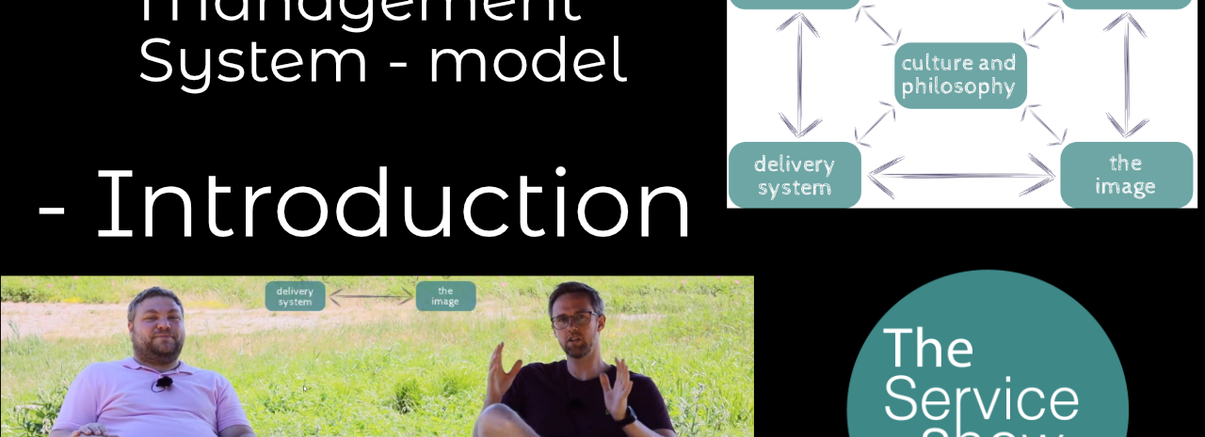

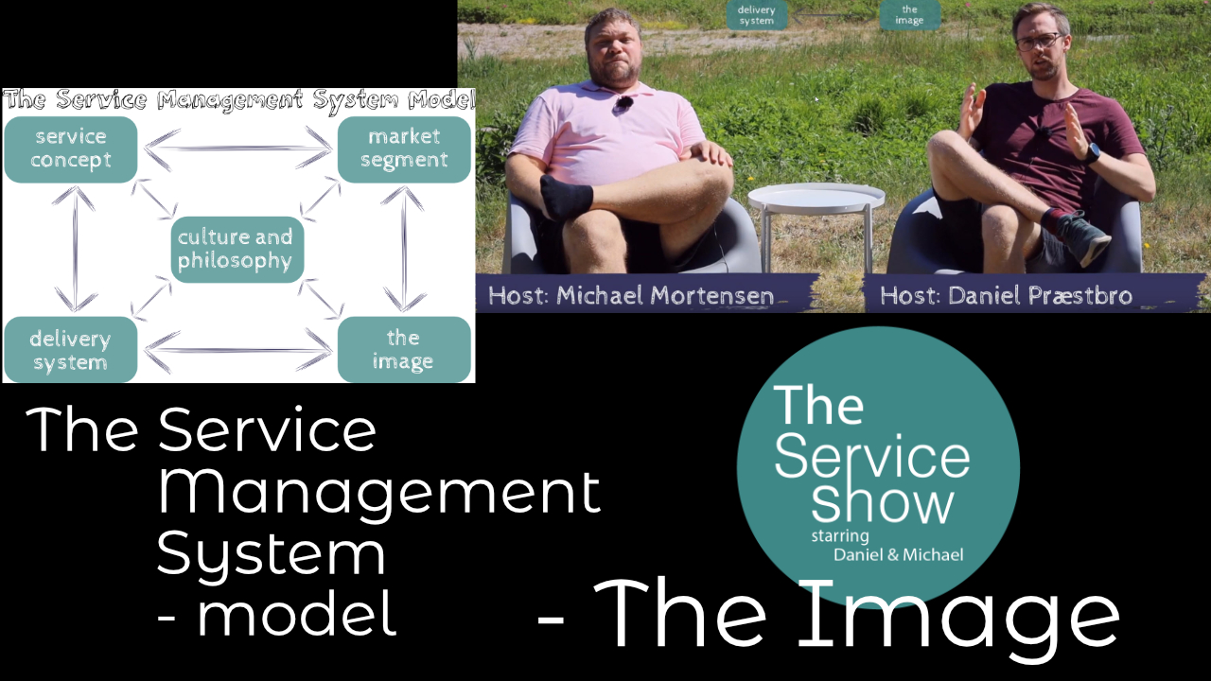
Tagesordnung
- What’s in it for you
- What is Learning Videos
- Tagesordnung
- Why are we experts
- Why do we use videos
- How to get started with videos
- How to make videos
- Our experiences
  - Does the creator matter
- Use linkedIn Learning
- The End

Slide 7
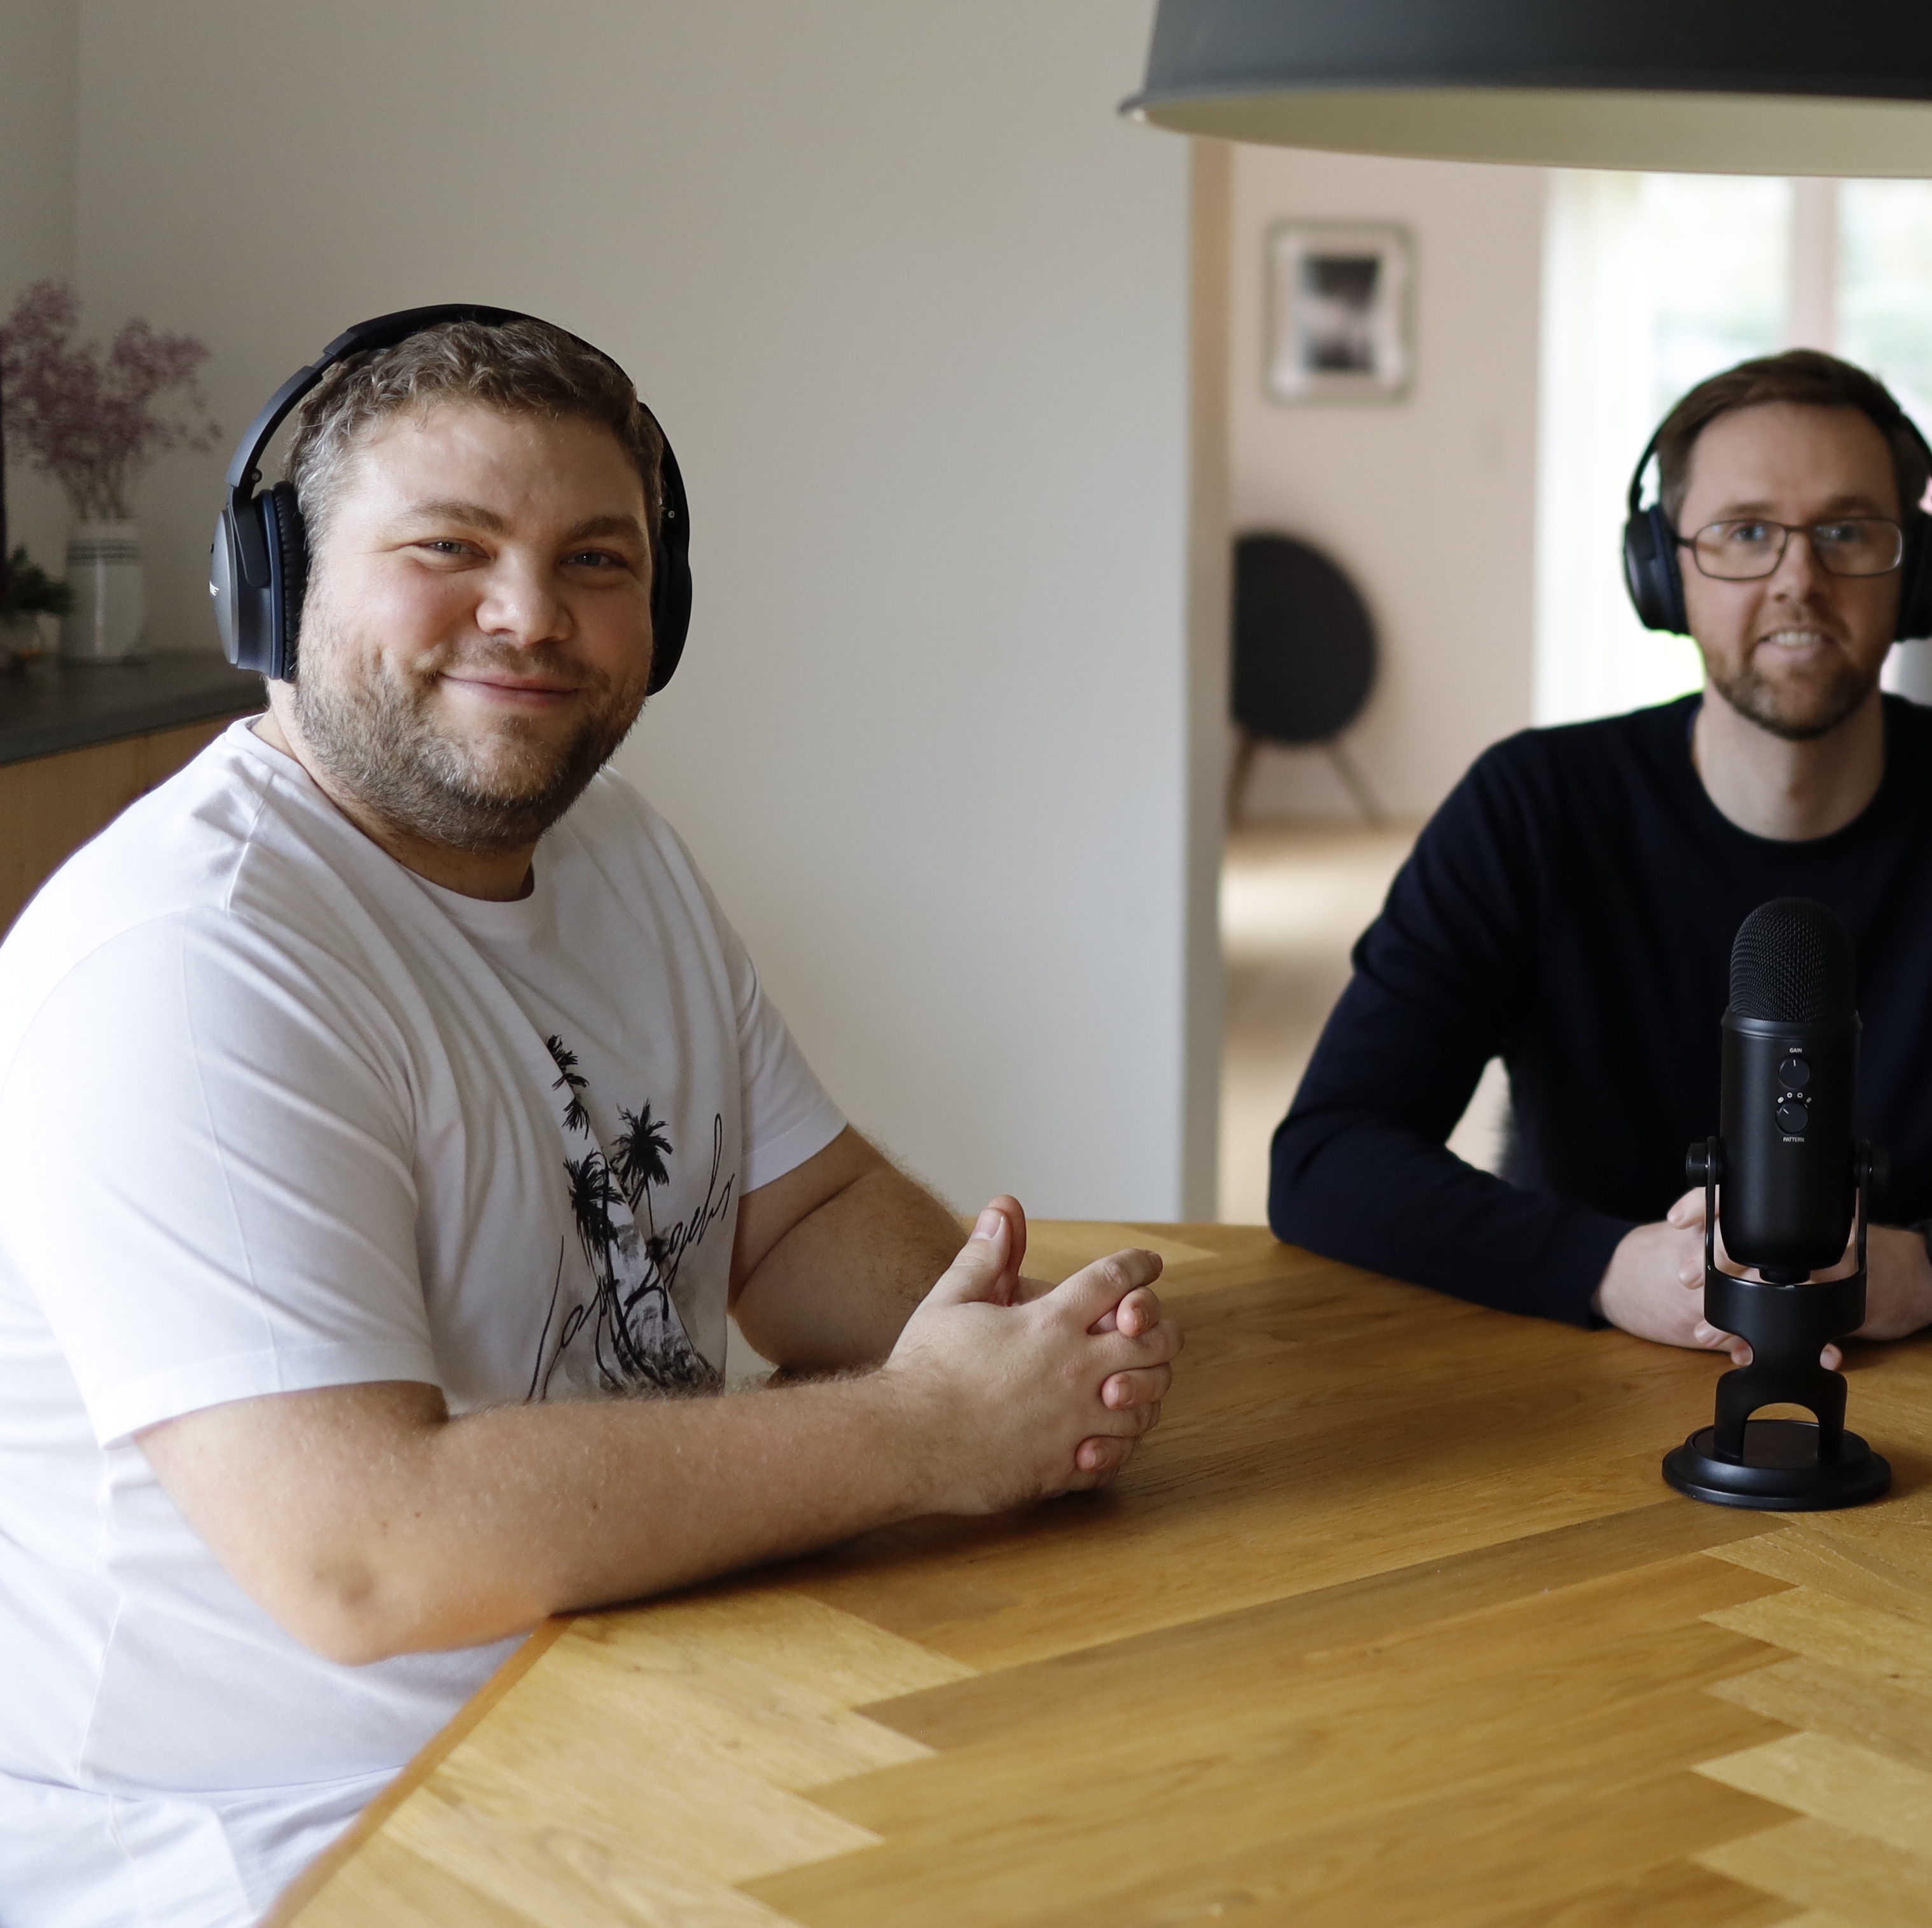
Why are we experts?
We have a done it for several days :)
Webpage / YouTube
Læringsstile

Slide 8
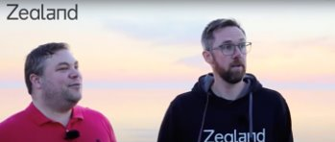
Why do we use videos?
Our personal motivation

Slide 9
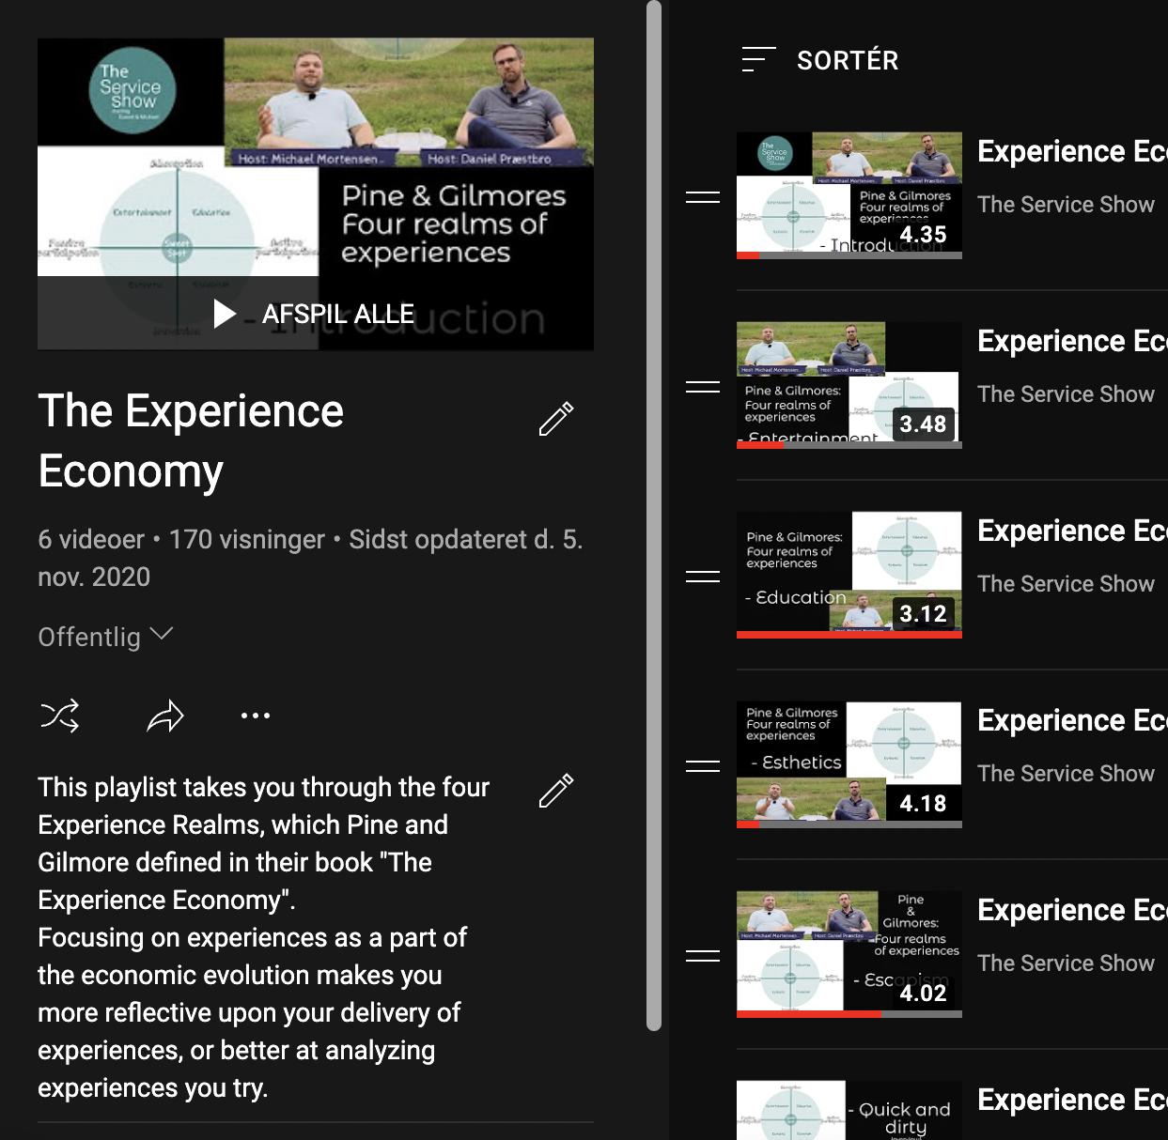
Use our playlists for the full experience

Slide 10
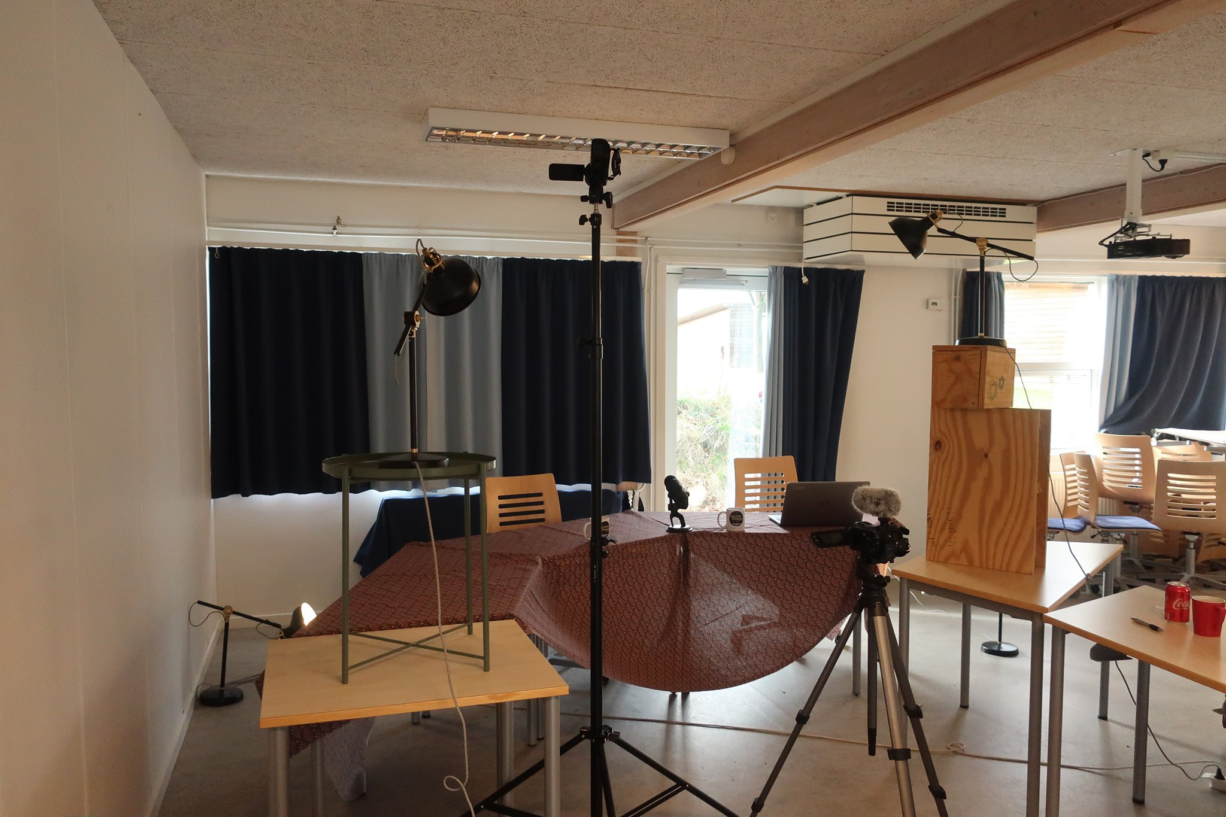
How to get started with videos
Why are videos a good platform?
Because everyone has a need to show off and become famous!
Everyone makes an extra effort if they have to record a video ...
People straighten their back, suck in their stomach and smile when a camera is put in front of them!

Slide 11
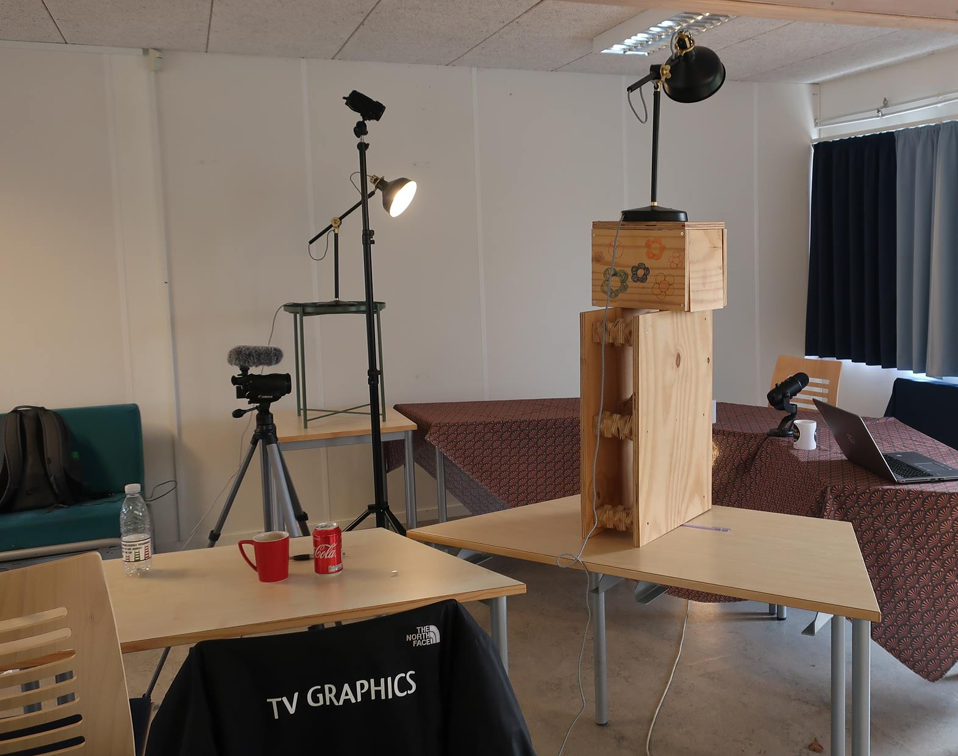
How to get started with videos (2)
Making videos

Slide 12
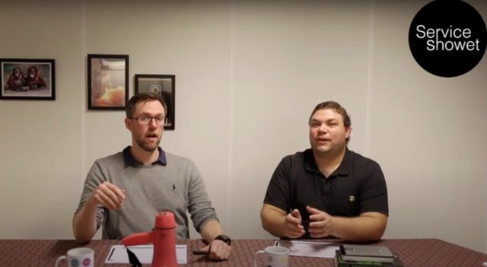

We are not teachers!
We are not teachers - we are not educators - we do not teach - nobody wants to be taught a lesson!
We are facilitors - we facilitate a proces, where students have a chance for developing - if they want to and/or wants to try...

Slide 13

Walk the Talk -
How to make videos

Slide 14


Our experiences
Make AND use
Comments and feedback
Before/during/after

Slide 15
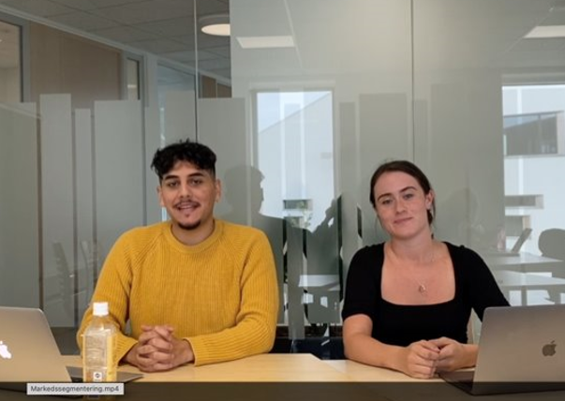
Thank you so much for doing this! It helps super much :) Could you make a video about income statement with debe and credit etc :)
Nice you made it! I'm closer to understanding.
Really good review of Schein culture theory and quick answers to questions that I will use for my exam :-)
Hi :) I'm glad I came across your site :) A suggestion for you, would you be able to do more about bookkeeping, VAT and accounting? :) You have a really good way to explain.

Slide 16
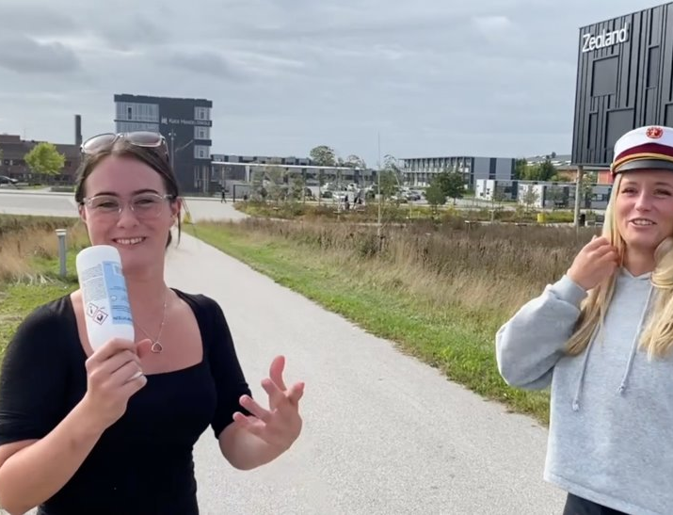
You are just brilliant 😊 Your work is so valuable! Now I understand much better all those concepts 🤓 With great gratitude
You are amazing
Really good video - Thanks for it :)
Do You have an education?

Slide 17

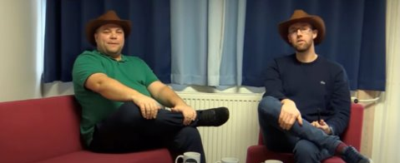
Does the creator matter?
Creating
and
Enhancing relations to students

Slide 18

Use LinkedIn Learning?
We are free of charge
But you can book us

Slide 19
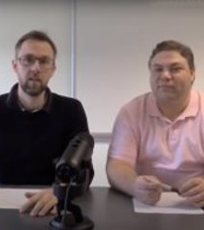
Summary – a few wise words ☺
Videos are not the only solution – but a supplement
Students become more proficient at an academic level
Students improve their presentation skills
Students get better at working collaboratively
It’s not about making it perfect - it’s the ”trying it your own way” that makes it authentic
This applies to both sender and recipient (teacher and student)
Equipment is secondary
We are two – that hightens the interdisciplinary approach
and in the beginning it helps overcome the nerves

Slide 20

The F***ing END
LinkedIn: Daniel Præstbro Nielsen and Michael Weitze Mortensen
Wepage: TheServiceShow.com
E-mail
  dani@serviceshowet.dk
  mimo@serviceshowet.dk
  Wepage: zealand.com

